Slide 1
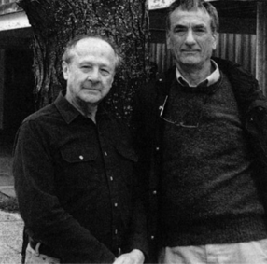
“The Most Beautiful Experiment in Biology” Meselson & Stahl: Semiconservative Replication of DNA
Mahip Grewal and Neha Somineni

Slide 2
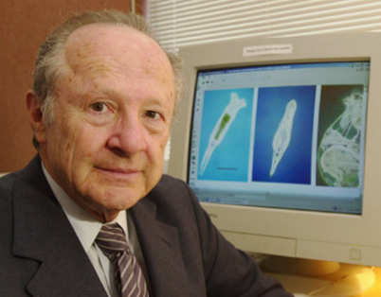
Matthew Meselson (Molecular Biologist & Geneticist)
Born May 24th, 1930 in Denver, Colorado
Labs in garage & basement
Graduated high school 2 years early
University of Chicago (chemistry), California Institute of Technology (Ph.D. under Linus Pauling→ x-ray crystallography, density centrifugation)
Since 1960-Professor at Harvard

Slide 3
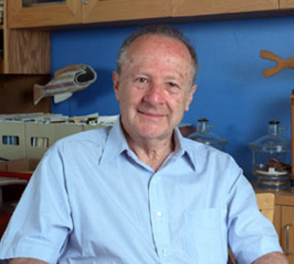
Franklin Stahl (Molecular Biologist & Geneticist)
Born October 8th, 1929 in Boston, Massachusetts
Studied at Harvard (A.B.) & University of Rochester (Ph.D.)
Researched at California Institute Technology & University of Missouri
Currently professor at University of Oregon

Slide 4
Woods Hole
1954: Meselon went to Woods Hole to be a teaching assistant
Stahl was a post-doctoral fellow at Woods Hole, where he was studying molecular biology techniques
Throughout the summer, Meselson and Stahl had discussions on theory and experiments
Shared similar ideas and were keen to work together
Stahl received a postdoctoral position in Caltech
Particularly interested in building off of Watson and Crick’s DNA model

Slide 5
The DNA Model
Watson and Crick’s DNA Model (1953):
Double-stranded helix
Right-handed
Nucleotides bases form interior; sugar phosphate backbone
Aligning with Chargaff’s rule →each purine paired with a pyrimidine (A-T, G-C sequences)
*Watson and Crick speculated that the specific base pairings were indicative of a precise mode of DNA replication
Meselson and Stahl sought to prove Watson and Crick’s hypothesis.

Slide 6
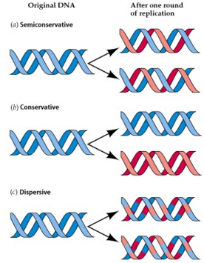
3 Major Hypotheses for DNA Replication
Semiconservative: each strand serves as template for replication
Conservative: intact double helix is copied in its entirety
Dispersive: replication results in hybrids consisting of old and new DNA

Slide 7
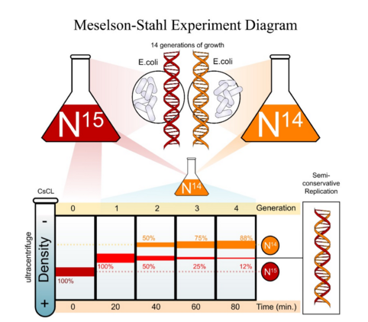
Meselson and Stahl’s Experiment (1958)

Slide 8
Overview
Utilization of isotope labels to differentiate between parent and daughter DNA
Chose ¹⁴N (common, lighter) and ¹⁵N (rare, heavier)→key element of DNA
Technique of cesium chloride equilibrium density gradient centrifugation
Separation of molecules based on density
Goal: detect whether new nitrogen atoms appear on 1 or both daughter strands

Slide 9
Methodology
Grew 14 generations E. coli in ¹⁵N (dense, would be at bottom of centrifuge)
Changed medium to ¹⁴N→from this point forward all DNA replicated in this medium
Periodically sampled the DNA grown in the ¹⁴N medium by means of equilibrium density gradient centrifugation to compare the percentage of ¹⁵N to ¹⁴N
Samples mixed with cesium chloride, centrifuged and allowed to settle
http://www.phschool.com/science/biology_place/biocoach/dnarep/cscl.html

Slide 10
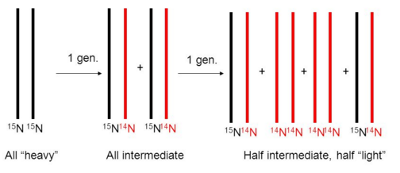
Results
DNA made up of only ¹⁵N formed a single band
First replication band located at midpoint between ¹⁵N and ¹⁴N
Second generation had two bands (1 at midpoint, 1 at ¹⁴N); same two bands seen subsequently

Slide 11
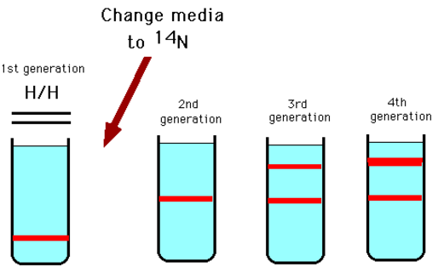
Semiconservative Replication
Meselson and Stahl elucidated the core mechanism of DNA replication

Slide 12
Contributions to Biotechnology
“Most Beautiful Experiment”→ forming predictions based on various models and pinpointing which matches experimental data
Addressed all models simultaneously
Demonstrated effective, unique mode of isotope visualization
Labeling not based on radioactivity but rather density (gradient analyzed by means of centrifugation)
Heavy isotopes are now widely used to label and analyze molecules

Slide 13
Advancing the Field of Molecular Biology
Semiconservative DNA replication has been confirmed in every other studied species
Understanding semiconservative DNA replication is crucial to elucidating functionality of cells and organisms
Genetic material must replicate completely and accurately during divisions
Furthered knowledge on mechanisms of DNA and its interactions with enzymes (i.e. helicase)
Having a grasp on proper DNA replication allows for identification of abnormalities underlying defects
Insights into heredity

Slide 14
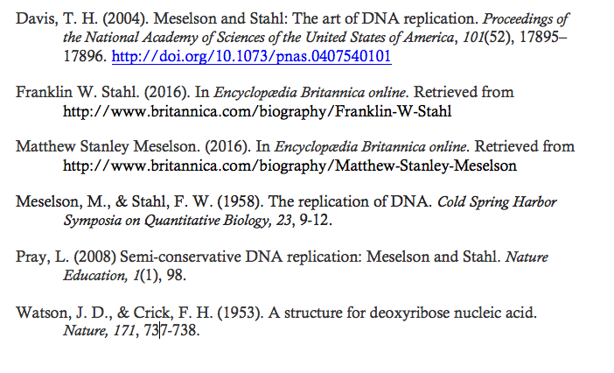
Sources

