Slide 1
Hershey and chase
By: Jon Shadan and Lindsey Snyder

Slide 2
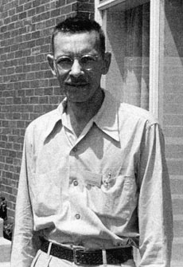
Historical background: A.d. hershey
Childhood to Undergraduate: Background Information
Alfred D. Hershey was born on December 4, 1908 in Owosso, Michigan.
He spent his time as a child in Lansing where his father worked as a stocker at an automobile plant.
Hershey attended Michigan State College in 1926.
When he was an undergraduate, he liked chemistry and bacteriology.
He earned a bachelor’s degree in 1930.

Slide 3
Historical background: A.d. hershey
Graduate Years
Hershey stayed at Michigan State College to complete graduate work in chemistry.
During this time, he was an assistant to one of his professors.
His chemistry experiments utilized brucella bacteria.
Brucella bacteria induce “undulant fever.”
Undulant fever is an infection spread from animals to people, mostly by unpasteurized dairy products.
He finished his doctorate in 1934.

Slide 4
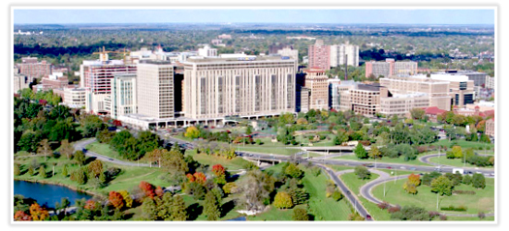
Historical background: a.d. hershey
Post-Graduate School
He took a job as an assistant bacteriologist to one of the professors.
This job was at Washington University School of Medicine’s Department of Bacteriology.
In 1936, he was promoted to instructor.
In 1938, he became an assistant professor.

Slide 5
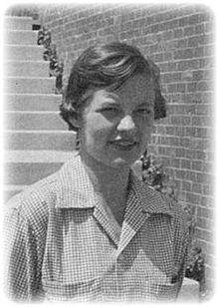
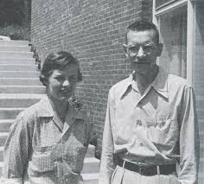
Historical background: Martha chase
Chase was born in Cleveland, Ohio.
In 1950, she earned a bachelor’s degree from the College of Wooster.
In 1964, she earned her doctoral degree from the University of Southern California.
Chase worked as an assistant at the Carnegie Institution of Washington in Cold Spring Harbor, NY.
Including the name of an assistant on a publication was peculiar during this time period (1960’s). Thus, it is remarkable that Martha Chase's name is linked to the famous “Blender Experiment” that revolutionized molecular biology.

Slide 6
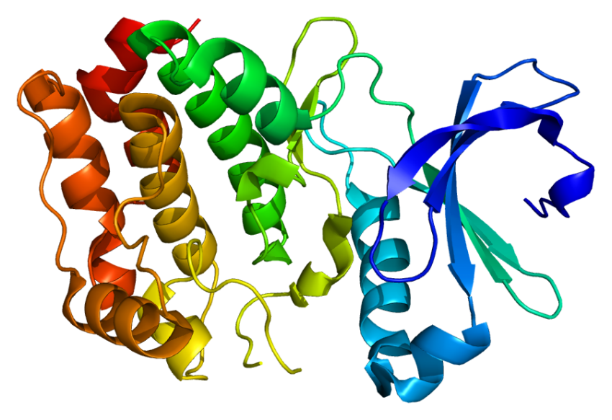
Purpose
The purpose of their experiments was to prove that DNA is genetic material.
At this time, it was still believed that proteins were genetic material because of their diversity, and that DNA could not be genetic material since it was similar in different organisms.

Slide 7
How they completed the experiment
There were two main experiments.
In the first experiment, they took T2 phages (bacteriophages), and labeled the phages DNA with radioactive Phosphorus-32.
In the second, they labeled the phages proteins with radioactive Sulfur-35.
Why Sulfur and phosphorus?
Since phosphorus is contained in DNA but not amino acids, radioactive phosphorus-32 was used to label the DNA contained in the T2 phage. Radioactive sulfur-35 was used to label the protein sections of the T2 phage, because sulfur is contained in amino acids but not DNA.

Slide 8
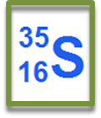
experiments
The phage were produced in a medium (substance) which contained Phosphorus-32 deoxyribonucleotides and thus created phage with radioactive DNA, but no radioactive capsids (protein sheaths).
In the second part of the experiment, the opposite happened. The phage were produced in a medium containing Sulfur-35 radioactively-labeled amino acids and the phage that were produced had radioactive capsids, but no radioactive DNA.
They used E. Coli (a bacteria cell, since bacteriophages infect bacteria cells) to track what happened to the cells and the phages in each experiment.

Slide 9
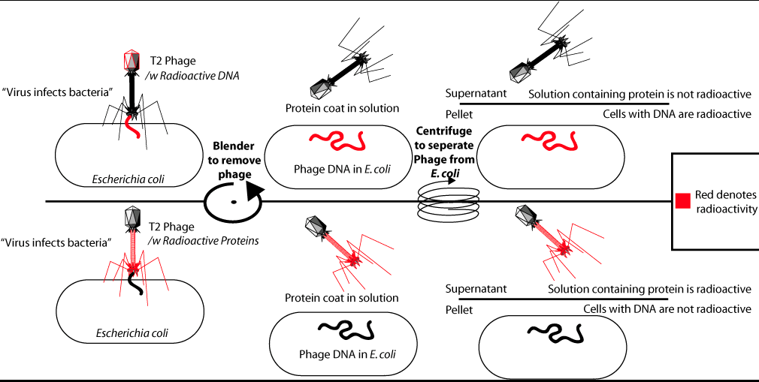

Slide 10
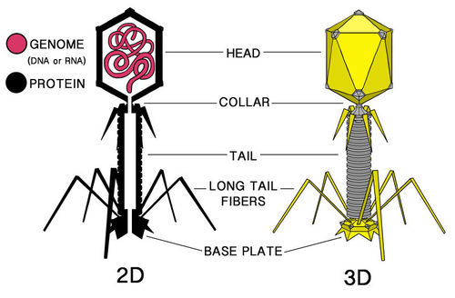
First experiment: observations
They saw that the radioactive element was now only in the bacteria and not in the phage.
This was because the bacteriophage injects its genetic material into the cell in order to reproduce, so it injects it into the E. Coli cell and uses the bacterial cell machinery to replicate.
The rest of the phage remained outside of the E. Coli cell, while the radioactive DNA was inside.

Slide 11
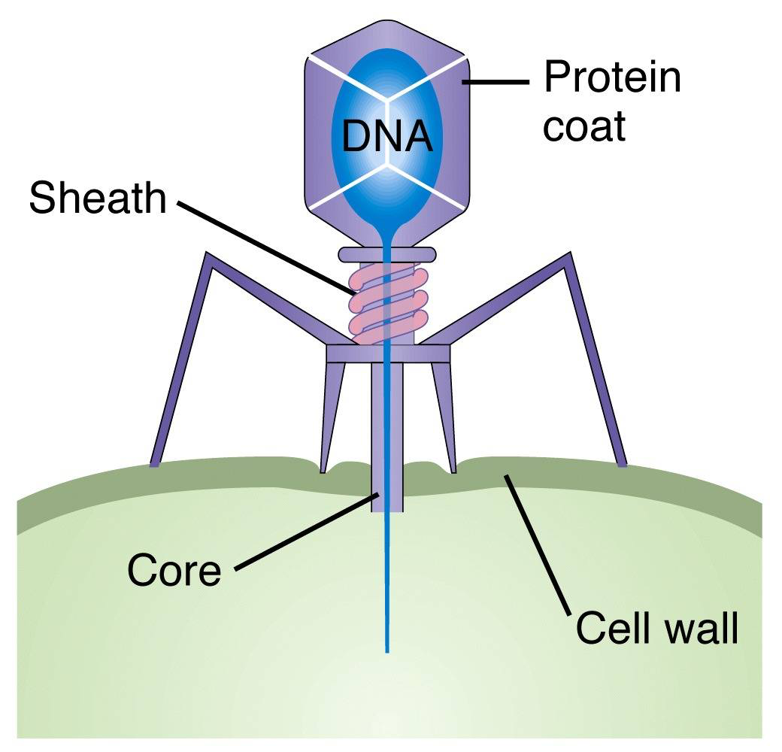
The second experiment: observations
The outside protein sheath of the bacteriophage was radioactive, not the DNA.
When the phage injected its DNA into the cell, nothing was radioactive. It was as if a normal bacteriophage infected a normal E. Coli cell, since the DNA of the phage was not radioactive.
Similar to the first experiment, the rest of the phage remained outside of the host cell.

Slide 12
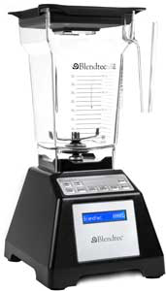
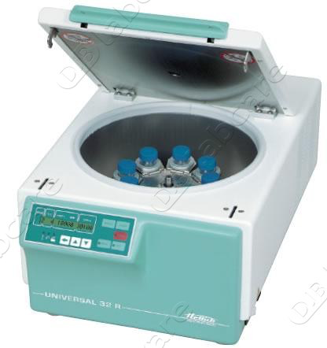
Blender and centrifuge
In order to measure the rate of radioactivity, Hershey and Chase used a normal household blender and a centrifuge.
They put the infected bacteria in a blender (on the highest speed) and waited while the blender violently disturbed the bacteria cell walls, causing the protein shells to detach from their hosts.
They then poured the mixture into a centrifuge, which separated the heavier cell wall protein from the lighter substances inside the cell.

Slide 13
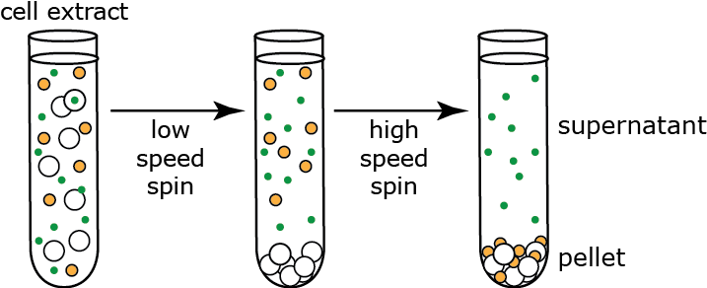
results
https://www.youtube.com/watch?v=682LLNdwZqs
The test tube had both a pellet (bacteria) and a supernatant (viruses)
They tested both the pellet and supernatant for radioactivity.
Radioactive sulfur was found in the supernatant which showed that the viral protein did not go into the bacteria.
For S-35 radioactive preparation (radioactive proteins), the radioactivity is in the supernatant
For P-32 radioactive preparation (radioactive DNA), the radioactivity is in the pellet

Slide 14
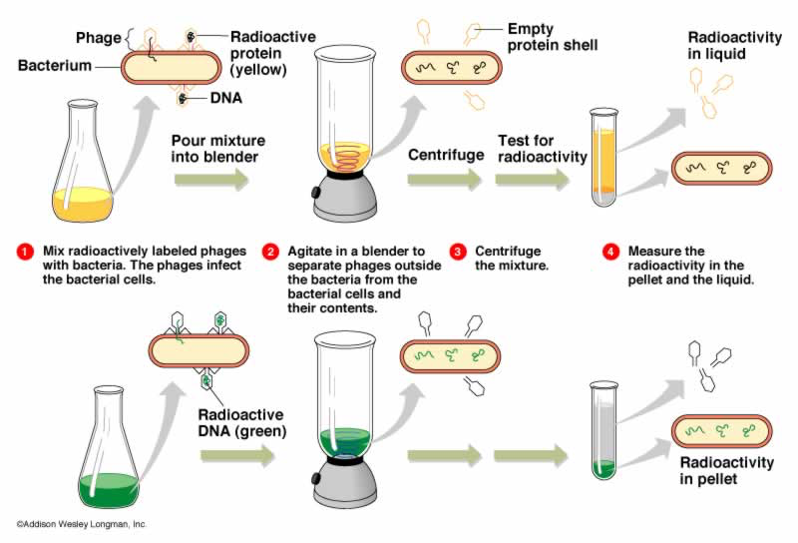

Slide 15
Contributions to biotechnology
One of the major workhorses of biotechnology, the plasmid, can now be used to create things that humans can use on a daily basis.
For example, insulin can now be produced by bacteria cells through plasmids at a much faster rate than before, and be given to diabetics that need it.
It is likely that it would have taken scientists much longer to figure this out without the discovery of DNA being genetic.
The Hershey and Chase experiments are the groundwork for experiments in biotechnology today.

Slide 16
Contributions to Biotechnology (Cont.)
Many experiments by other scientists (ex. Griffith) would not be possible without the discovery of DNA as genetic material.
Since this discovery, scientists have come a long way with DNA.
They now have the human genome project, which essentially maps out all of the genes of the human genome from both a physical and functional standpoint – all possible because of Hershey and Chase’s discovery.

Slide 17
sources

